Slide 1
Airport Evacuation Simulation
By
Jeff Ruffin & Titus Thomas

Slide 2
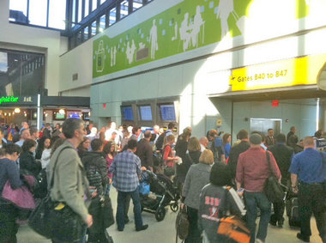
Airport Evacuation/Security
Terminal at Newark airport evacuated after man enters secure area through exit By Steve Strunsky/The Star-Ledger
Newark Airport Evacuated Over Baby Security BreachBy Andre Tartar
Auckland airport evacuated after alarm activated January 31, 2012 by Sky Today ·

Slide 3
Goals and Objectives
Create a virtual simulation of an evacuation at Dulles Airport
Through virtual simulation, show effective ways to conduct an evacuation.
Show a room, outdoor, and individual perspective for the airport evacutation.

Slide 4
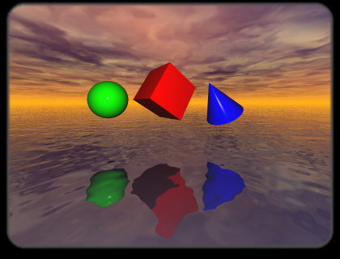

Software Used
VRML (Virtual Reality Modeling Language)
Autodesk 3d Studio Max

Slide 5
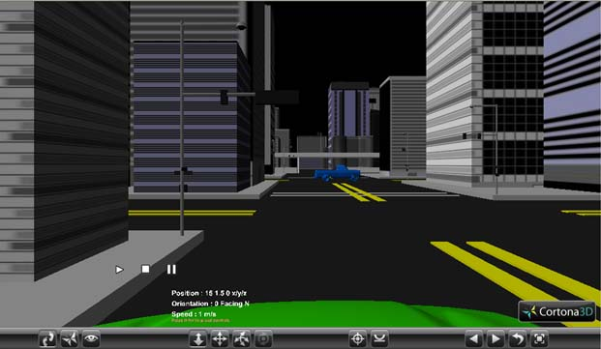
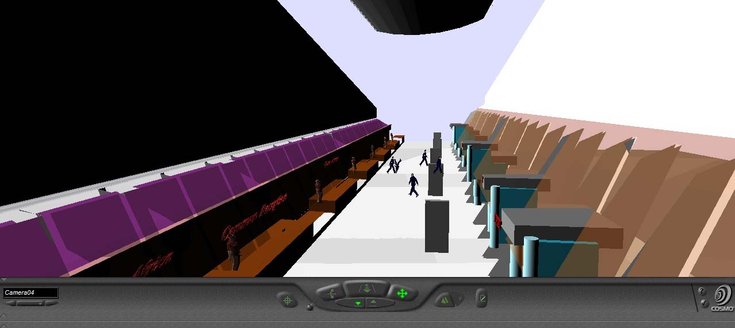
Big thanks to
Anderson Donovan and Quander Namkisha (2010 Airport Simulation)
Tyreek Edwards (Virtual City)

Slide 6
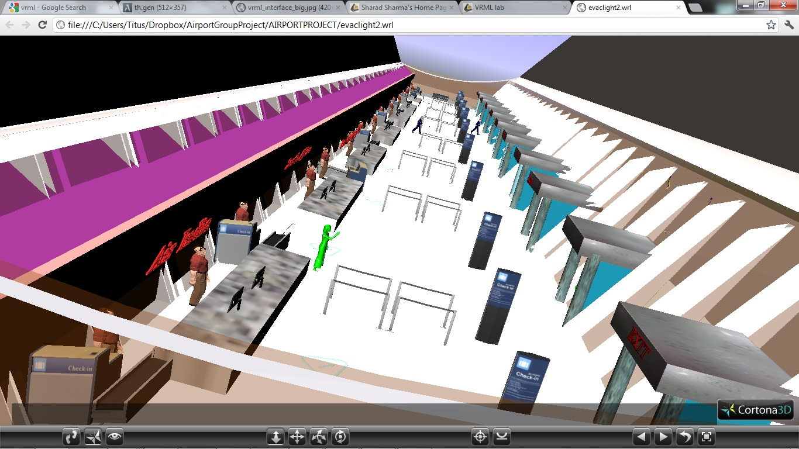
Our Airport

Slide 7
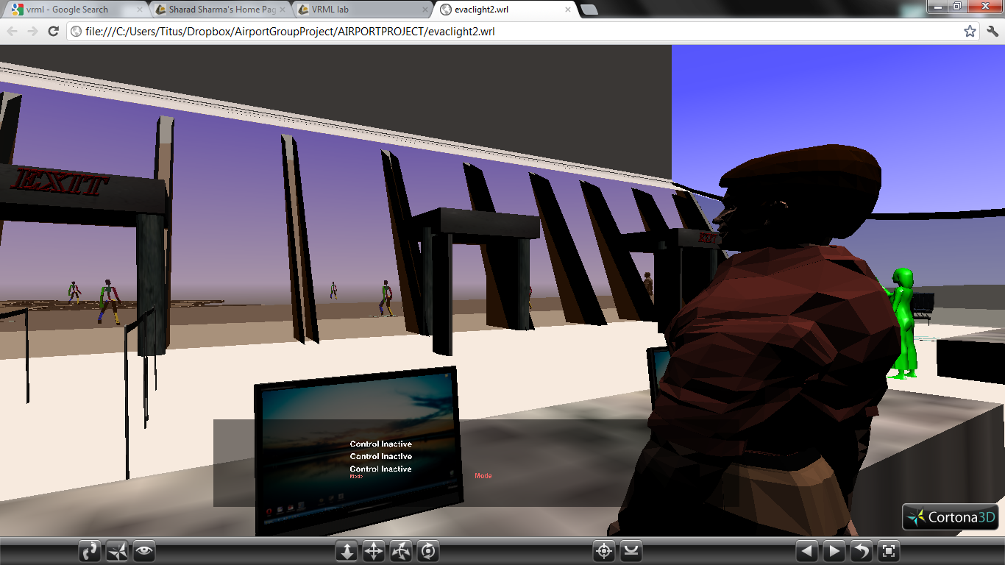
Modeling
Lights- We used a Daylight System from 3ds Max
Animation- 3ds max CAT rig Skeleton was used for the people leaving the airport
Java script in VRML was used to take control of the pedestrian Character

Slide 8
Why this is Useful
Different Airports will require different evacuation procedure as they all have different architecture.
Using 3d Simulations is much more efficient than gathering a mass of people and having them re-evacuate the airport over and over.
It is much cheaper (and more realistic) to reproduce fires, explosions, any catastrophe using a 3d environment than in real life.

Slide 9
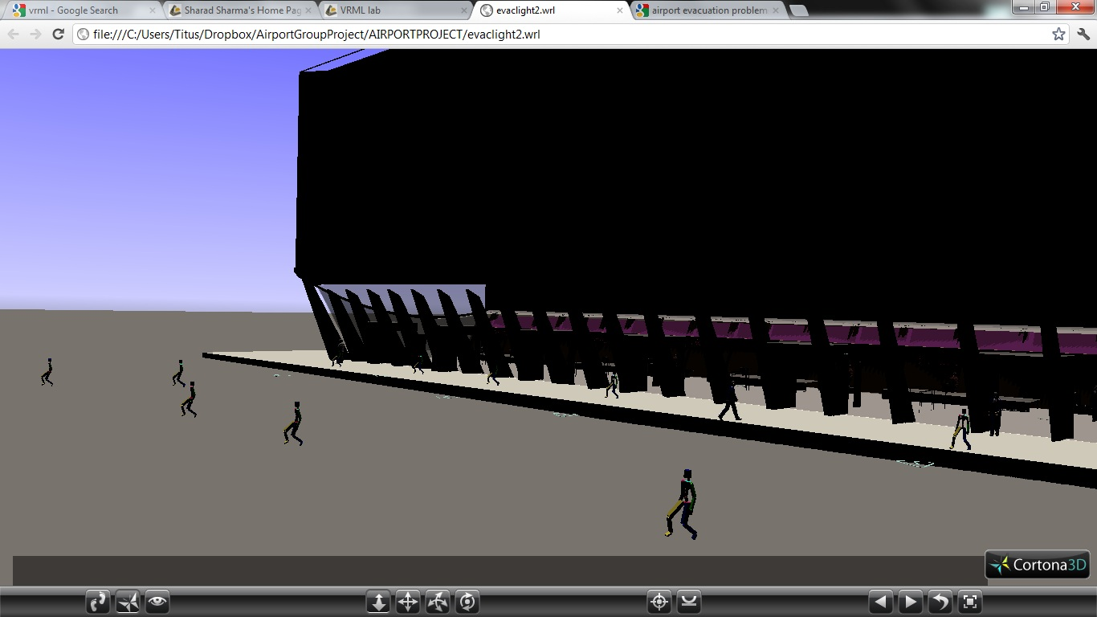
The Downside
Converting 3ds Max to VRML and VRML to 3ds Max
Preserving Textures during file Conversions
Minor bugs (airport roof glitch, constant crashing during animations, textures disappearing and re-appearing)

Slide 10
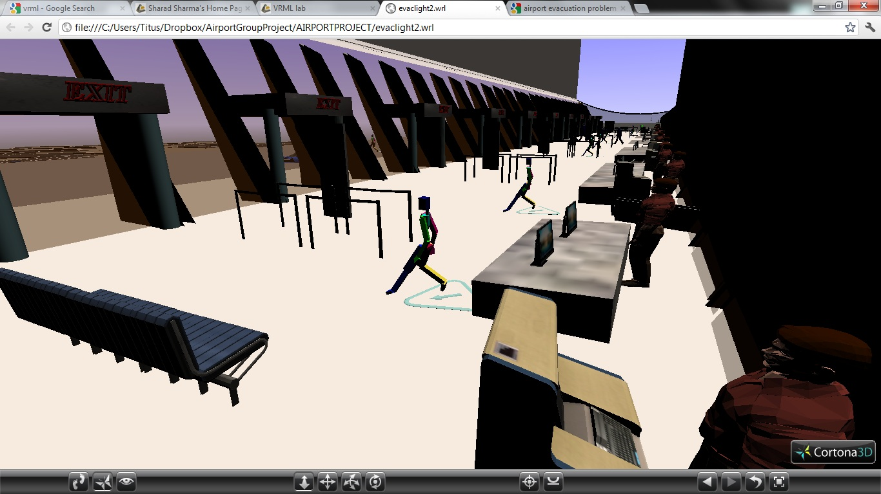
Potential Improvements
To improve this model we can insert the catastrophe. (fire, bomb, plane crash, natural disaster)
We can add meshes to the walking skeletons in the environment.
Add Animated employees.
Add a Multi-User Environment

Slide 11
The End

